Slide 1
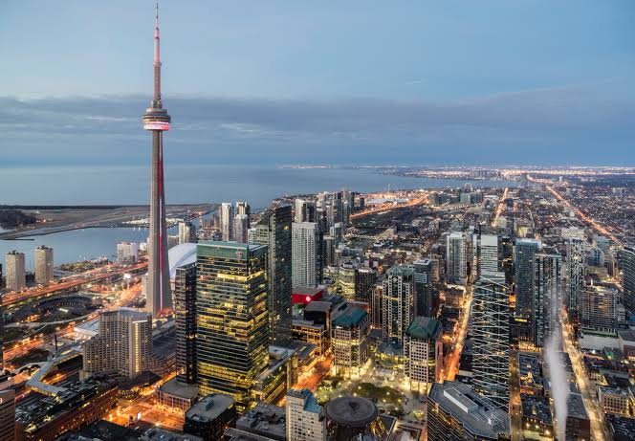
Exploring Toronto -XYZ Organizers
- Yaswanth Gummadi

Slide 2
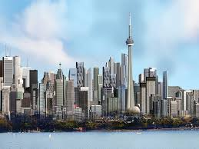
Toronto Background
Provincial Capital of Ontario and most populous city of Canada.
An international centre of business, finance, arts, and culture, and is recognized as one of the most multicultural and cosmopolitan cities in the world.
A prominent centre for music, theatre, motion picture production, and television production, and is home to the headquarters of Canada's major national broadcast networks and media outlets.
Its varied cultural institutions, which include numerous museums and galleries, festivals and public events, entertainment districts, national historic sites, and sports activities, attract over 43 million tourists each year.
Highly diversified economy with strengths in technology, design, financial services, life sciences, education, arts, fashion, business services, environmental innovation, food services, and tourism.

Slide 3

Business Problem
Creative Arts Inc. is a global company dedicated to the world of creative arts. It was formed to revive the Creative arts domain. Here artists are encouraged to follow their passion and their work is displayed throughout the world at different events, conventions etc for fund raising, training and selling of the work of artists. They leverage technology to get funds and revenues and to increase the awareness of the Creative Arts among general populace.
XYZ is a company based in Toronto for organizing events, currently it works on a project for Creative Arts Inc. to organize an event for 5 days for a group of artists from all over the world. The company has to put a good program, including a hotel of residence, a hall for meetings, places of landscape to visit, stores for shopping, restaurants and cafes.
The company’s purpose is to make a list of places of landscape in Toronto, including the nearest restaurants, cafes, and shopping stores for each place.

Slide 4

Stakeholders
The artists are obviously the main stakeholders. They would prefer to have info about places with common hangout spots.
The general population would also prefer active places for hanging out or even for interacting with the artists.
The client- Creative Arts Inc. would be having sufficient opportunities to display the work of their artists to larger client base and gather more sales.
Even the hotels or any such new businesses would be preferring a larger footfall for their new business.

Slide 5


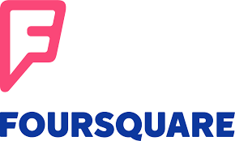
Data Description
For starters, we need Toronto location data. We would be getting the coordinates of the city of Toronto using geopy package in Python.
Then using those coordinates as reference points, we would be using the Foursquare API to retrieve different locations of hotels, parks, restaurants, cafeterias etc. Using the Foursquare API, we can get wide range of information about any particular location.
Then finally we would be plotting those points on a map using Folium package in Python to identify places with maximum activity/footprint for the artists attending the event and also for tourism purposes.

Slide 6

A Customizable Solution
In our solution, we are looking at Toronto city, for hotels in 0.5 km radius for our event space, parks in 10 km radius, restaurants in 10 km radius, cafeteria in 10 km radius and shopping in 1 km radius.
For example, we can do the same for New York city or London city or Tokyo. All these are possible thanks to geopy package and Foursquare API.

Slide 7

Methodology
We start by importing the required packages for our solution. They would include numpy, pandas, json, geopy, matplotlib, folium.
We define our Foursquare credentials for using the solution.
We define the city and get its latitude and longitude using geopy package.
We search for hotels in 500m radius, Parks, Restaurants, Cafeterias in 10km radius and shopping malls within 1km radius. with reference to city’s latitude and longitude using Foursquare API explore option.
We export the results into a json file and assign the relevant part of the json file into a dataframe.
We clean the dataframe to keep only relevant location data for each venue in the dataframe. Then we proceed to deal with column names, dropping unnecessary columns, removing null values, removing duplicate records, and ensure that the category of venue in our dataframe is relevant.
Finally we have explicit dataframes for hotels/event spaces, parks, restaurants, cafeterias and shopping malls.
We plot them on maps using Folium package of Python.

Slide 8
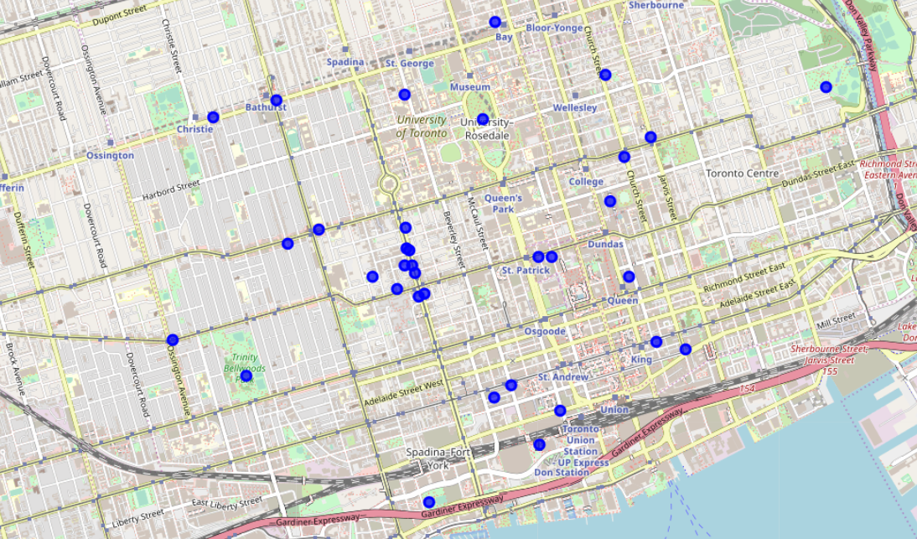
Dataset 1-Restaurants, Parks and Cafeterias
These can also be used to day planning for both artists and clients who want to experience the city through tourism

Slide 9
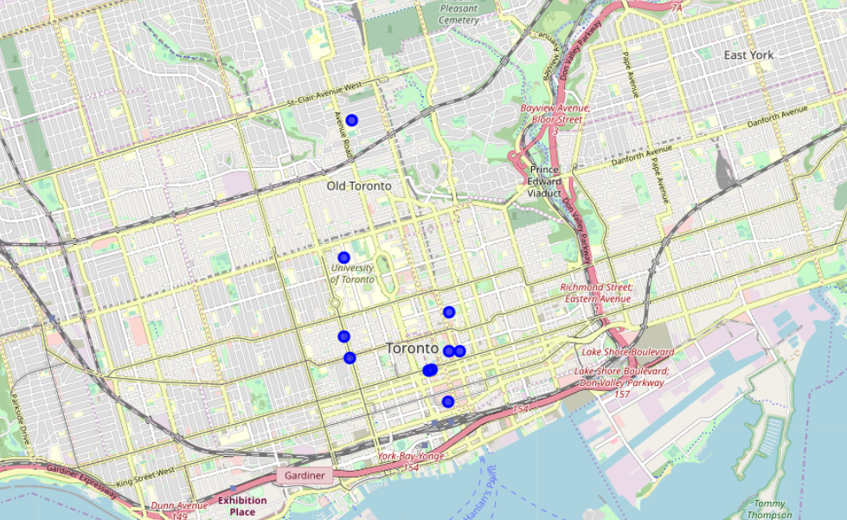
Dataset 2- Hotels/Event Spaces, Cafeterias and Shopping Malls
This is for the artists and the clients attending the art convention and exhibition.
They can proceed for a coffee at a cafeteria and go shopping for souvenirs for their trip.

Slide 10

Discussion
We have a five day event at say Grand Ballroom. The artists can be being accommodated at Sheraton Centre Toronto Hotel. The hotel can be recommended for any clientele arriving exclusively for our event. They can have their meals at any of the cafes available in the list. They are fairly closeby and we have three shopping malls where they can proceed for their trip memories and souvenirs.
We have a Bellevue Square Park, Rol San Restaurant, Shadow Restaurant, Goldstone Noodle Restaurant, New Sky Restaurant, Ka Chi Korean Restaurant, Green Tea Restaurant Downtown, Tasty’s Caribbean Restaurant, El Rancho Restaurant & Night Club, Kensington Cornerstone Restaurant and Stay Cafeteria in a close proximities. Artists and clients can start their day with a breakfast at Kensington Cornerstone Restaurant, proceed to the park, have lunch at any of the above listed places and end the day at El Rancho Restaurant & Night Club.
The above are cases of event organization and day planning respectively

Slide 11
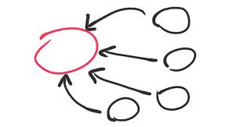
Conclusion
We as XYZ event organizers created a customized solution for exploring a city based on client preferences. We achieved the solution using Python and used Foursquare Location Data to arrive at the solution. In this case, the client happens to be a Creative Arts Inc and we executed the solution for Toronto City for one of their art conference and exhibitions.
THANK YOU!

